Slide 1
OverDrive Scenery Editor
User Guide
ver 1.0

Slide 2
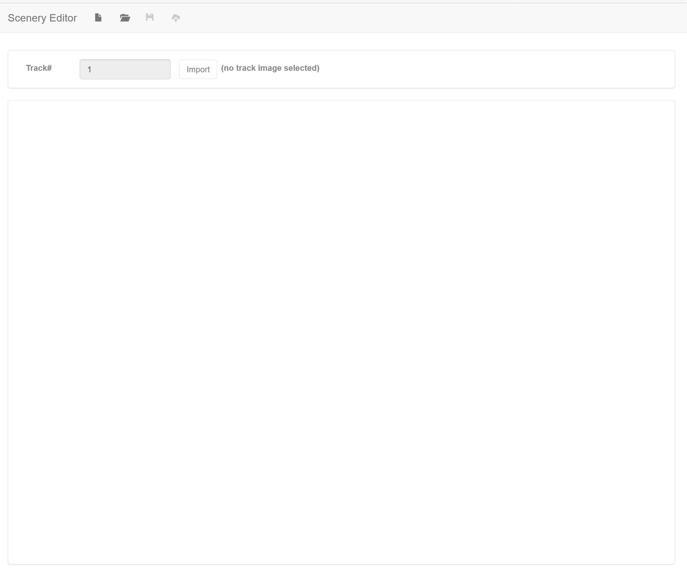
1. Scenery Editor Overview…
The Scenery Editor is very similar to the Track Editor, but whereas the Track Editor is designed to specify where the players should go, the Scenery Editor is designed to allow you to specify where on your track image the players cannot go. For example, we use the Scenery Editor to tell the game engine where buildings and obstacles are so the cars cannot drive through them!
On first loading the Scenery Editor, you are presented with a blank canvas. Along the top of the window are icons to create a new scene model, open an existing scene model, save the current scene model and export the scene model for use in the game.
The main Scene Editor window consists of a dialog to set the track / level number (which defaults to level 1) and an import button to load a track image you’ve already created in an application such as Photoshop.
To start a new scene model, click the New icon [1] and select the Import button [2] to load your track image.
1
2

Slide 3
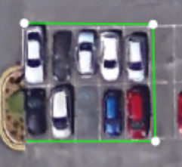
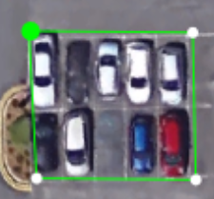
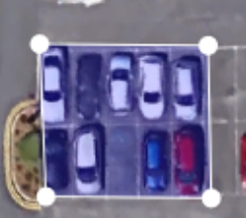
2. Creating a Scene Model…
The track image itself has no information about what are obstacles and what are not. Adding this information is the purpose of the Scenery Editor tool. This is done by creating a number of polygons that approximate the background scenery and obstacles that we see when playing the game…
To create a polygon, left click on the edge of a scenery feature or obstacle. In this example we’ll trace a polygon around the cars. You’ll notice a dot appear and a line follow your mouse cursor.
Continue to click different points to define your polygon. To complete the polygon, move your mouse cursor over the first point you created – it will turn green…
…Left click to complete the polygon. You’ll notice it will fill in in semi-transparent blue. If it’s red it means the polygon is concave. Don’t worry for now – we’ll tell you how to move points around later.

Slide 4
Quick tip 1…
It’s possible to move points around once a polygon has been created…
Move your mouse cursor over the point you want to move (it’ll turn green as before). Press control (ctrl) and left click the point. Now, instead of creating a new polygon, you’ll be able to drag the point around the screen. This will allow you to fine tune your polygon shapes.
You can also use this method to connect up disconnected polygons by matching points up along a shared edge.

Slide 5
Quick Tip 2
If you make a mistake you can press the delete (Del) key and this will delete the last polygon created.
If you’re tracing a polygon and make a mistake pressing “Del” will remove what you’ve traced so far so you can start your new polygon from scratch!

Slide 6
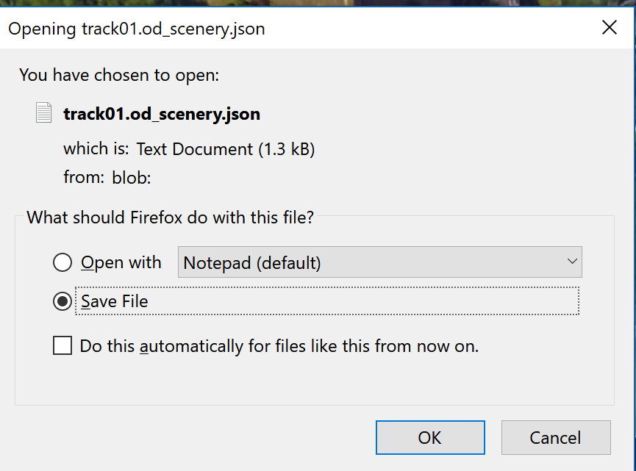
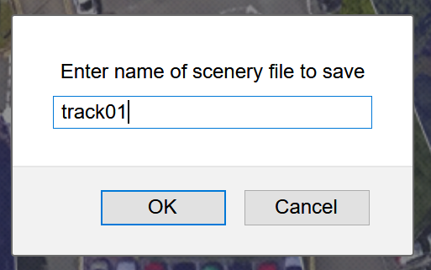
3. Saving your scene model…
In game development, developers will often save data in one format to work on. This format will be different from the format used in the game engine – when playing the game we want to use a file format that is quick to load so the player doesn’t have to wait too long!!!
The Scenery Editor has a save icon at the top of the screen. Because we’re working in a browser, this will create a new file for you in your Downloads folder…
The OverDrive engine is designed to work locally on your PC, without the need of a separate server (though of course this is possible)!
As such, we don’t want to leave our scenery model in the Downloads folder. Instead, copy your scenery model file and paste it into the Editor->Models subfolder in the main project folder. This is where the Scenery Editor will expect to find your file when it loads it later.
When you click the “Save” icon you’ll be asked to enter a name for the scenery file. Here I’ve used “track1”…
… you’ll then be asked to Open or Save the file. We’ll Save the file! Click “OK” to do this. You’ll notice the actual file is now called track1.od_scenery.json. This is a JSON file that contains the information about the scenery. You can look at this in any text editor. As noted above, this is located in your Downloads folder.

Slide 7
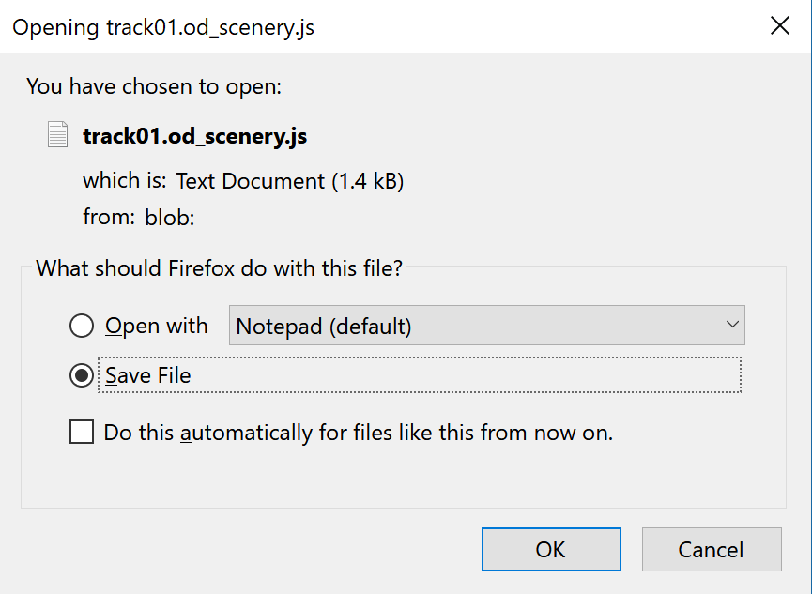
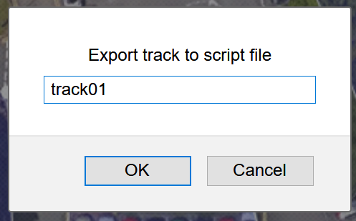
4. Exporting your scene model…
Exporting the scene model is different from saving. Instead of creating a JSON file to load back in later, it creates an actual JavaScript file to load into the game itself. As before, this is saved to your Downloads folder. You don’t usually export your scene model until it’s finished!
As with the Save file option, we don’t want to leave our exported scene model in the Downloads folder. Instead, copy your scene model file and paste it into the Levels subfolder in the main project folder. This is where the game engine will expect to find your file when it loads it later.
When you click the “Export” icon you’ll be asked to enter a name for the scenery file. Here I’ve used “track01”…
… you’ll then be asked to Open or Save the file. Again, we’ll Save the file! Click “OK” to do this. You’ll notice the actual file is now called track1.od_scenery.js. (it may be called track01.od_scenery.js.txt depending on the browser). Again, you can look at this in any text editor. As noted above, this will be located in your Downloads folder.

